Slide 1
EPFL Space Center eSpace
Space Propulsion ENG-510

Slide 2
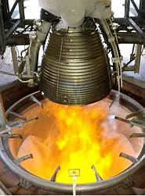
Lecture # 3 Part # 3 Introduction in Propulsion Systems
Brief overview on all space propulsion systems

Slide 3
Which Chemical Propulsion Systems exist?
Gaseous propulsion systems
Liquid propulsion systems
Objective: To develop the basics of chemical liquid propulsion
Gelled propulsion systems
Combustion
Hybrid propulsion systems
L3 – Propulsion Systems
Chemical Propulsion Systems
Space Propulsion ENG-510
Solid propulsion systems
Rotation Detonation Engine
Detonation
Pulse Detonation Engine

Slide 4
Which Chemical Propulsion Systems exist?
Tri-propellant
Mono-propellant
Liquid propulsion systems
Combustion
Bi-propellant
L3 – Propulsion Systems
Chemical Propulsion Systems
Space Propulsion ENG-510
Rotation Detonation Engine
Detonation
Pulse Detonation Engine

Slide 5
Which Chemical Propulsion Systems exist?
Objective: To develop the basics of chemical liquid propulsion
Liquid propulsion systems
Monopropellant, bi-propellant or tri-propellant
Storable or cryogenic propellants
Toxic or non-toxic (hazardous or green) propellants
Hypergolic or non-hypergolic propellants
Pressure-fed (self-pressurization, blow-down or regulated) or pump-fed propulsion
In this course the liquid propulsion systems are split into mono-, bi- and tri-propellant systems
Within this classification the other categories are mentioned (e.g. toxic, non-toxic)
L3 – Propulsion Systems
Space Propulsion ENG-510

Slide 6
Which Liquid Mono-propellant Propulsion Systems exist?
Objective: To develop the basics of chemical liquid mono-propellant propulsion
Liquid propulsion systems
Monopropellant, bi-propellant or tri-propellant
Storable or cryogenic propellants
Toxic or non-toxic (hazardous or green) propellants
Hypergolic or non-hypergolic propellants
Pressure-fed (self-pressurization, blow-down or regulated) or pump-fed propulsion
L3 – Propulsion Systems
Space Propulsion ENG-510

Slide 7
Which Liquid Mono-propellant Propulsion Systems exist?
Propellant Phase in Tanks
Solid
Liquid
Gas
Objective: To develop the basics of chemical liquid mono-propellant propulsion
Liquid propulsion systems
kit
Combustion
L3 – Propulsion Systems
Space Propulsion ENG-510
Chemical Reaction
Decomp
Hydrazine (N2H4) / HTP (H2O2) / ADN / HAN / LMP
Monopropellant Thruster
HAN..Hydroxyl Ammonium Nitrate
ADN…Ammonium Di-Nitramide
LMP-103S…ADN + Methanol + Water + Ammonia
No

Slide 8
Which Liquid Mono-propellant Propulsion Systems exist?
Objective: To develop the basics of chemical liquid mono-propellant propulsion
Liquid propulsion systems
kit
L3 – Propulsion Systems
Space Propulsion ENG-510

Slide 9
Which Liquid Mono-propellant Propulsion Systems exist?
Objective: To develop the basics of chemical liquid mono-propellant propulsion
Architecture for Liquid Monopropellant Decomposition Propulsion Systems:
L3 – Propulsion Systems
Regulator
Space Propulsion ENG-510
R
Tank
Exhaust
Pressurant
Tank
Valve
Catalysator

Slide 10
Which Liquid Mono-propellant Propulsion Systems exist?
Objective: To develop the basics of chemical liquid mono-propellant propulsion
Characteristics of a Monopropellant Propulsion System
Relatively simple, robust, cheap
Toxic propellant (Hydrazine is very often used) but also more and more ‘green’
Catalysator is needed for decomposition
Blow-down mode is very often used (ratio of 4 to 1)
Pressure range between 5.5 bar to 24.6 bar
Isp is between 210 to 230 s (Exhaust velocity of 2.0 km / s to 2.3 km / s)
Thrust between 1 N to 1 kN
Modular set-up is possible using COTS (cost optimization)
Temperature and heat exchange must be controlled
L3 – Propulsion Systems
Space Propulsion ENG-510

Slide 11
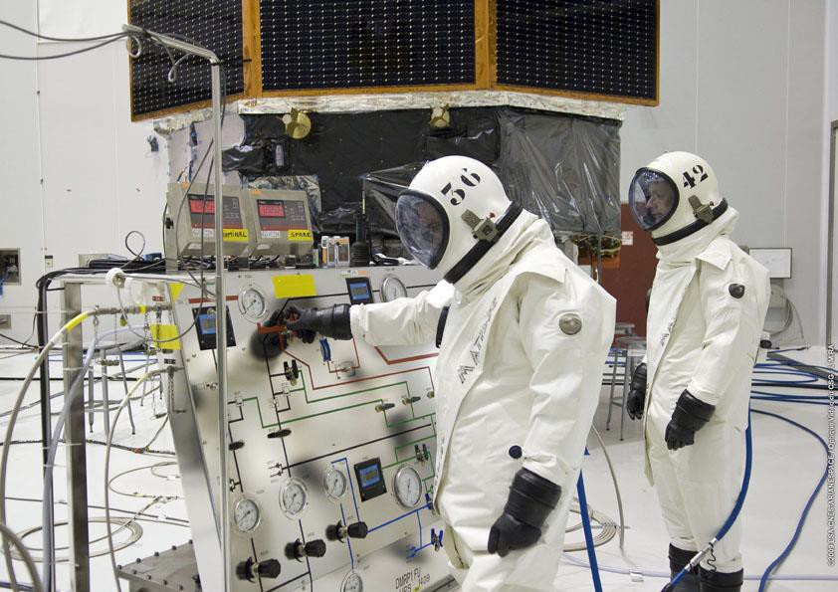
Which Liquid Mono-propellant Propulsion Systems exist?
Objective: To develop the basics of chemical liquid mono-propellant propulsion
Liquid propulsion systems
kit
L3 – Propulsion Systems
Space Propulsion ENG-510

Slide 12
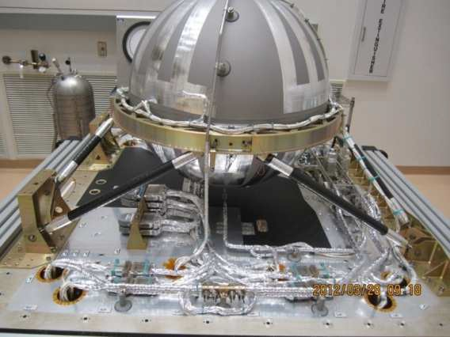
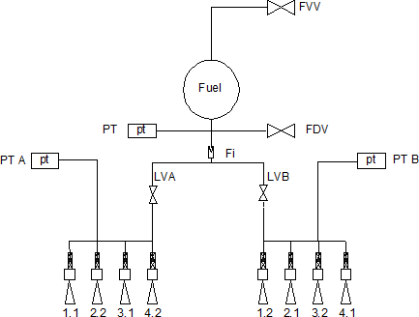
Which Liquid Mono-propellant Propulsion Systems exist?
Objective: To develop the basics of chemical liquid mono-propellant propulsion
Mono-propellant propulsion systems
kit
L3 – Propulsion Systems
Space Propulsion ENG-510

Slide 13
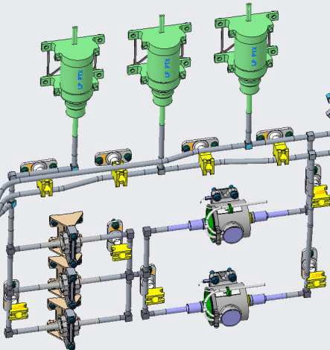
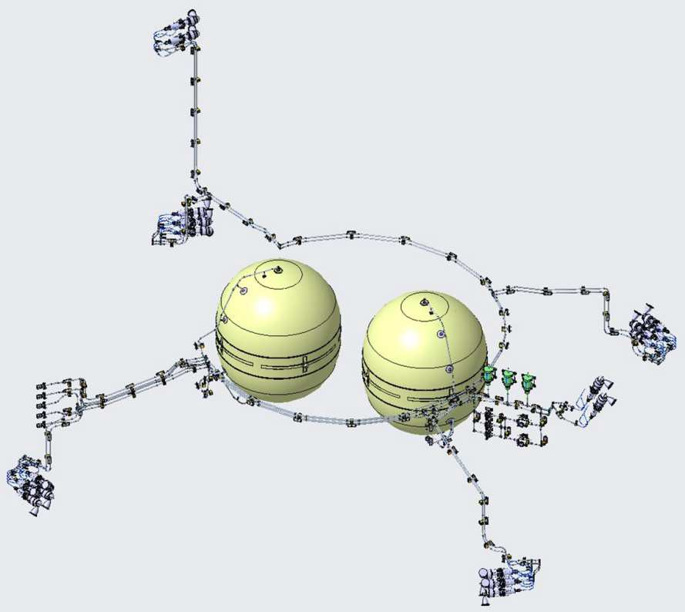
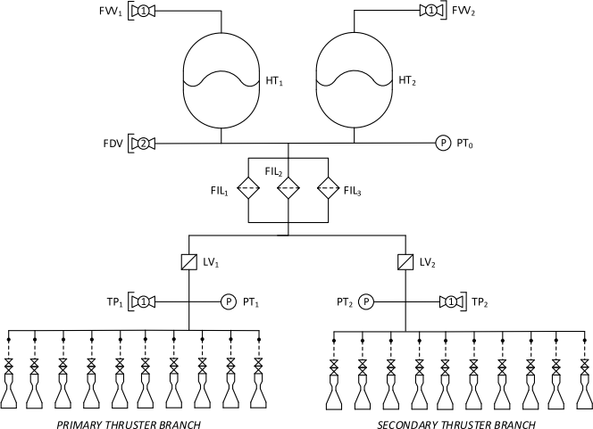
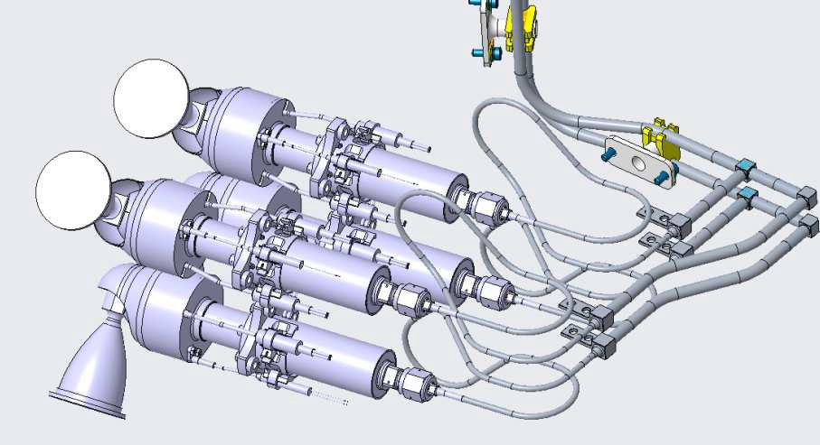
Which Liquid Mono-propellant Propulsion Systems exist?
Objective: To develop the basics of chemical liquid mono-propellant propulsion
Mono-propellant propulsion systems
kit
L3 – Propulsion Systems
Space Propulsion ENG-510

